Slide 1
A-TEAM
Shane, Jerome, Kannan and Siraj

Slide 2
Our Variables
Time Line : 2001 -2007
Variables:
Temperature
Population Density
Target Variable: Energy Usage

Slide 3
Our Questions
What correlations can we draw between the changes in temperatures and energy consumption?
Looking at our graphs, which one of the two variables have the most impact on Energy consumption?
Do high temperatures affect Energy Consumption more than low energy?
Does Population Density impact Energy Consumption?
What state consumes the most energy?

Slide 4
Process and Data Wrangling
Ton of energy data but it was hard to identify areas (ex. by power company, energy production, …)
Longer term energy data was by state by month
Energy data was in multiple different measurements
7 hours worth of API pull time to get the temperature data
Process:
Assemble data sources
Merge the data
Analyze the individual areas

Slide 5
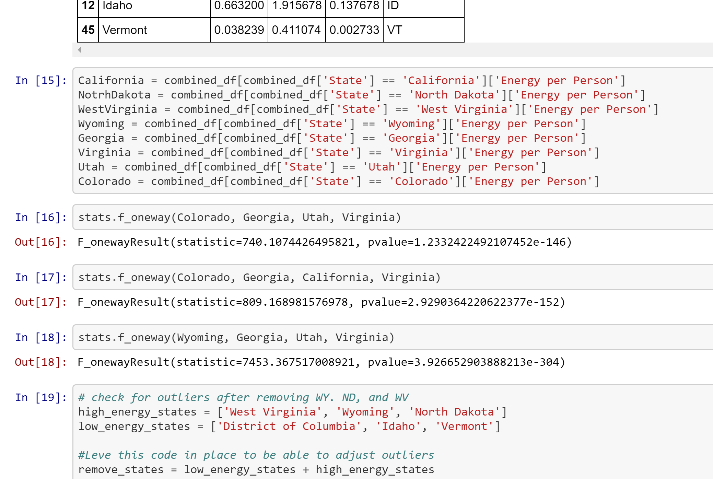
Anovas, and more anovas….

Slide 6
ENERGY USAGE
Primary sources of energy in the US is fossil fuels
Data source we are:
catalog.data.gov
data.world
Observations
Scale had to be adjusted
Removed data that is too low or high so as to have a readable chart
Compared output with data in public forums
Domain knowledge is important. I was able to fix lot of data issues because of my general understanding of the field

Slide 7
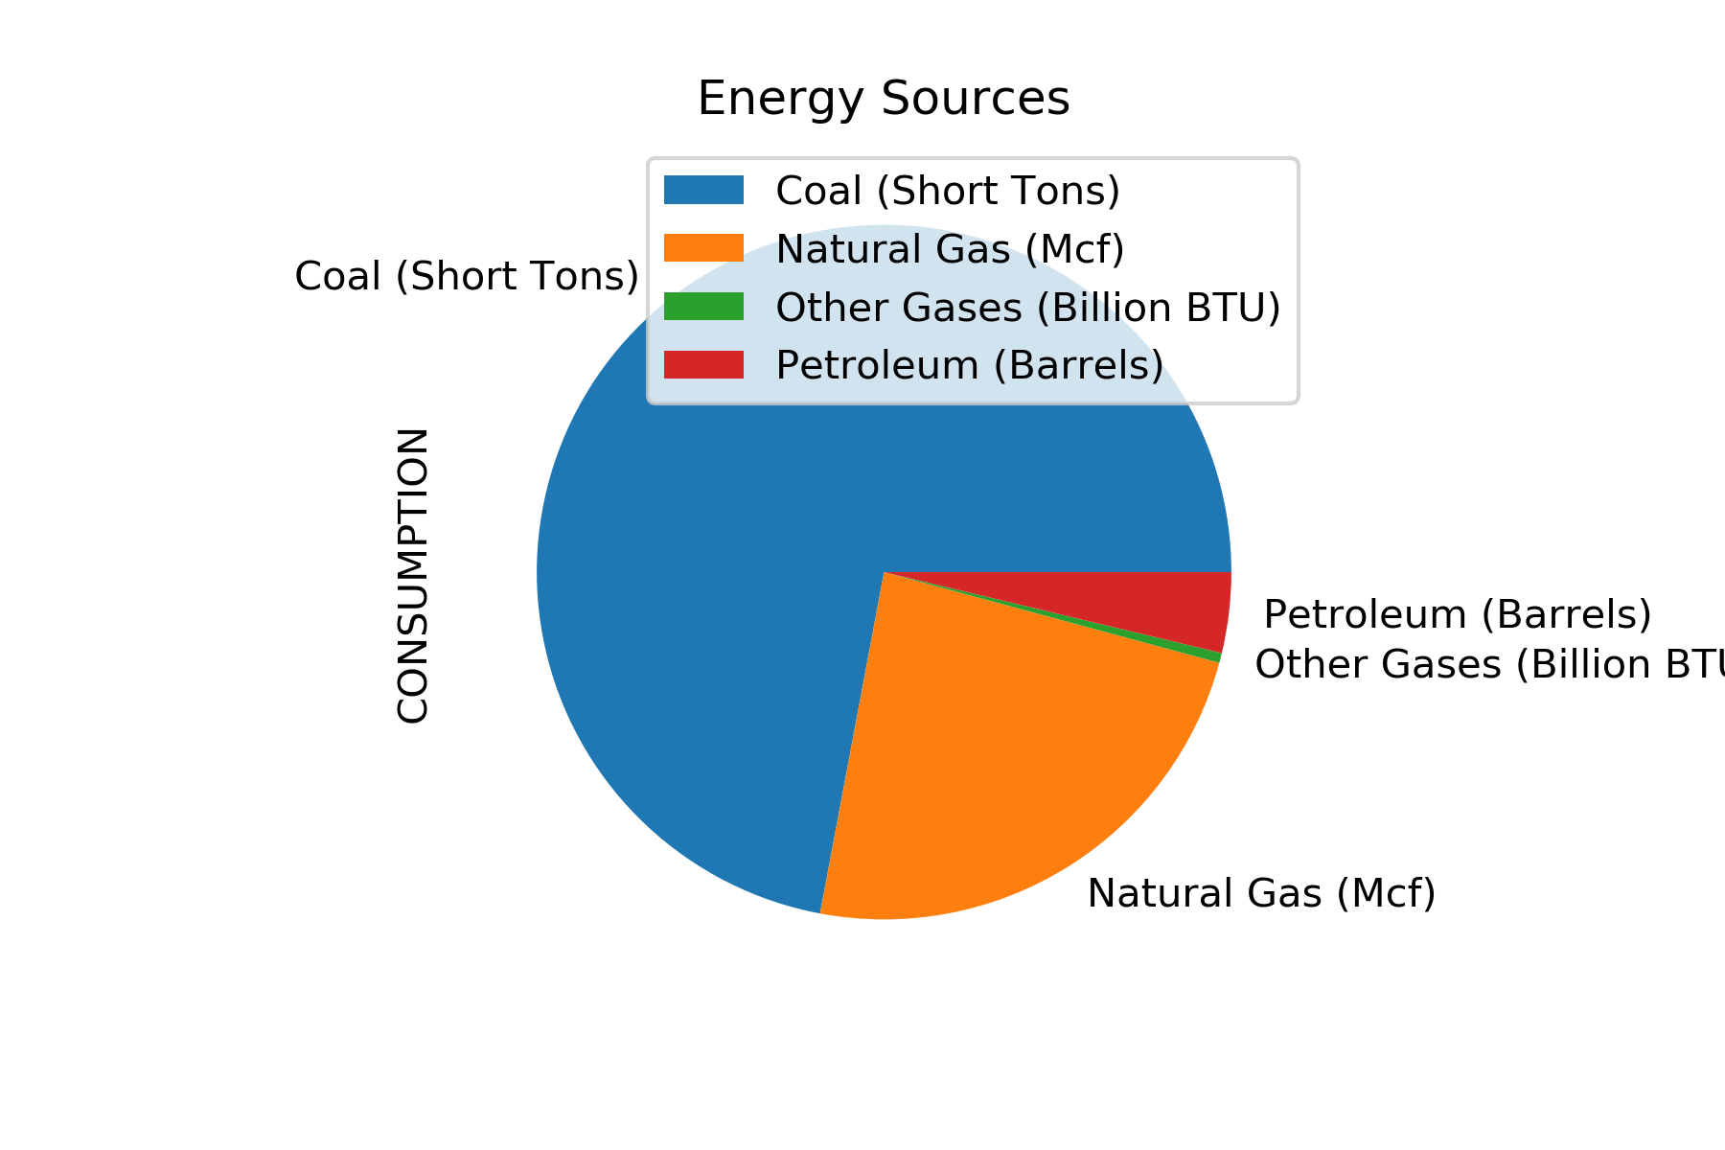
Largest Fossil Fuels consuming states

Slide 8
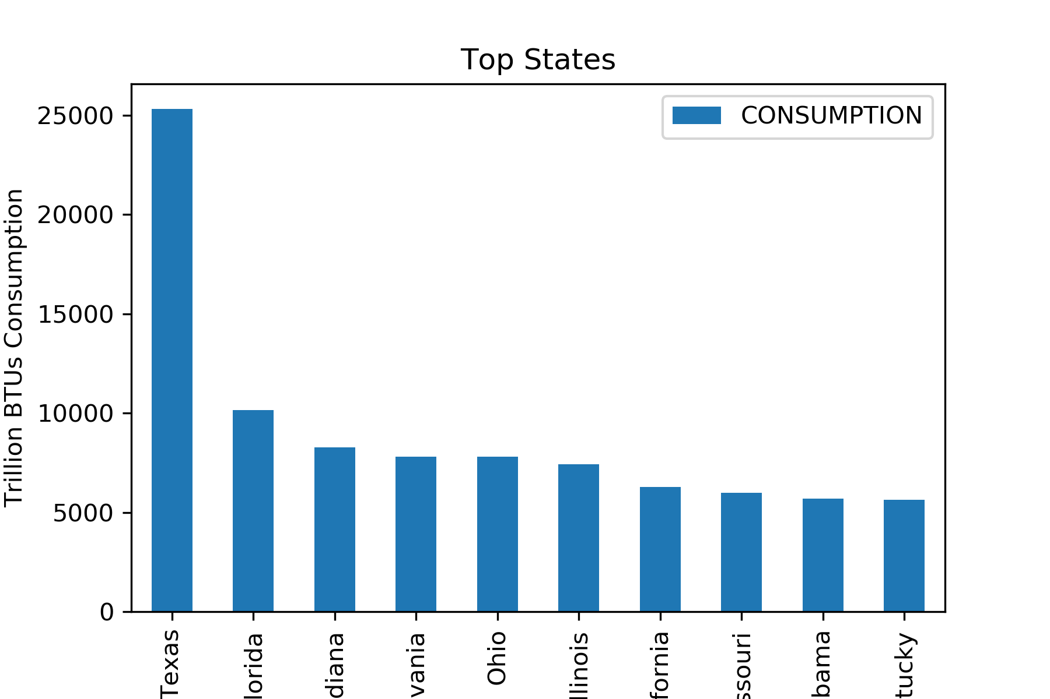
State Consumption

Slide 9
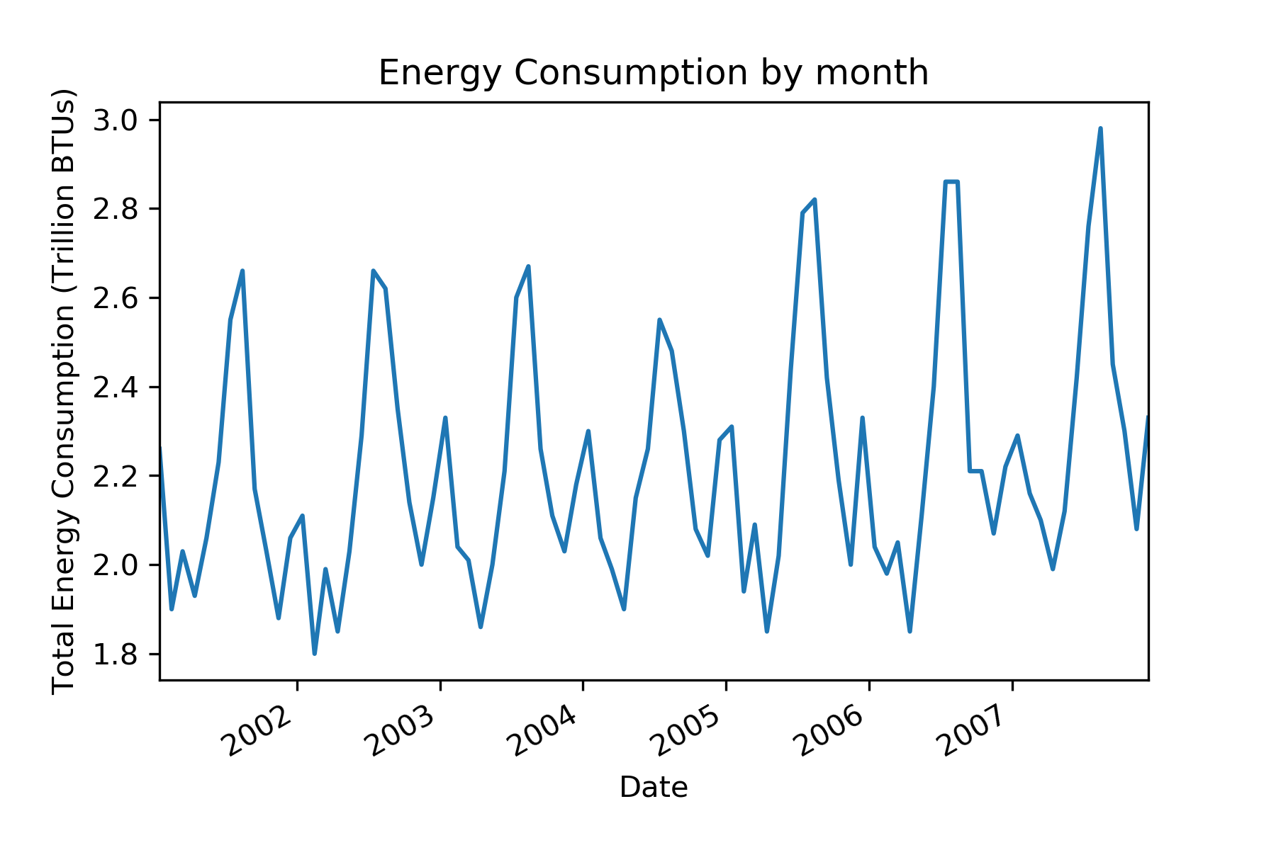
Monthly Analysis

Slide 10
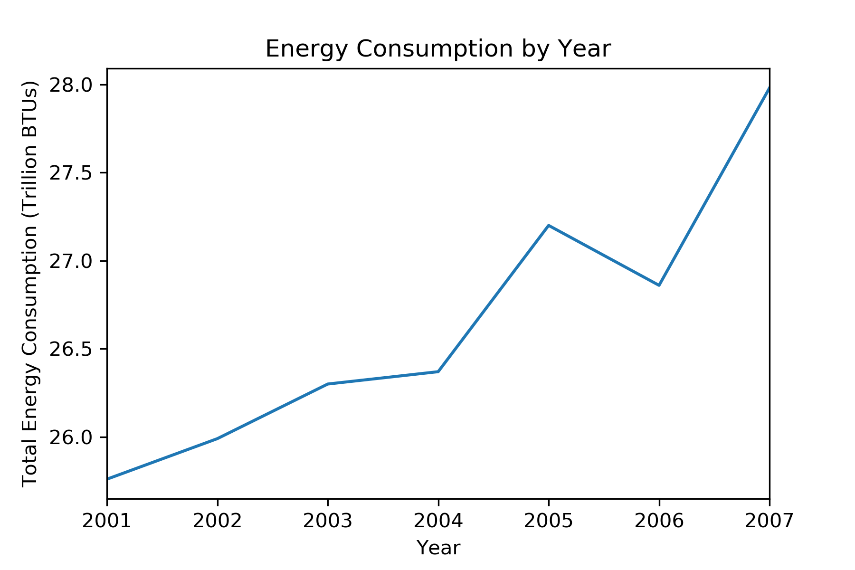
Yearly Analysis

Slide 11
Population Density
Population analysis
•US population by state has had a gradual increase across all 50 states including district of Columbia from 2001-2007 except Michigan •Less dense population areas consume more energy per person •The majority of population growth change stayed under 500,000 residents

Slide 12
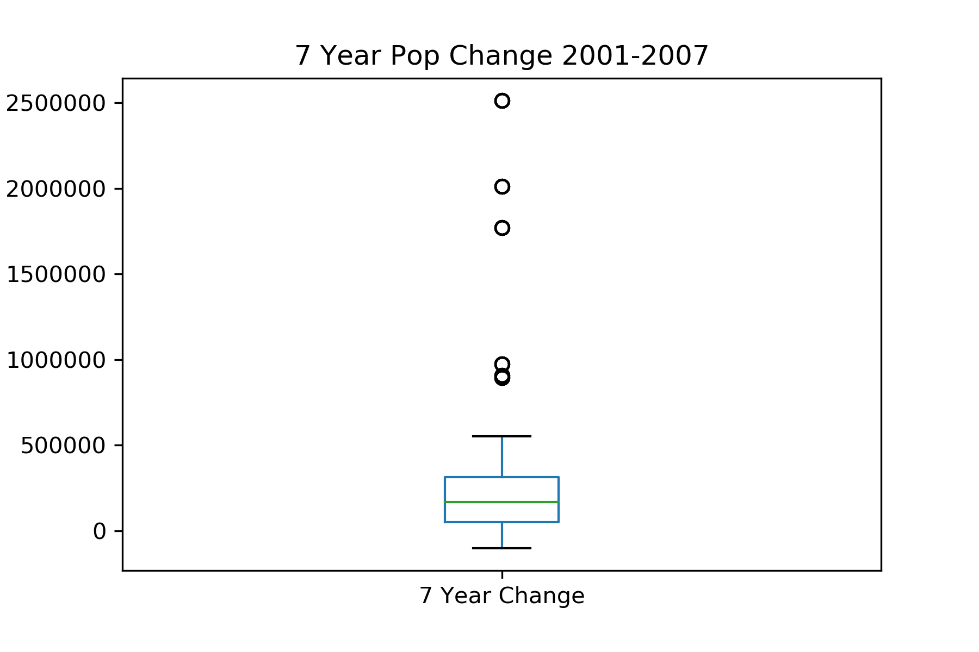
Analysis

Slide 13
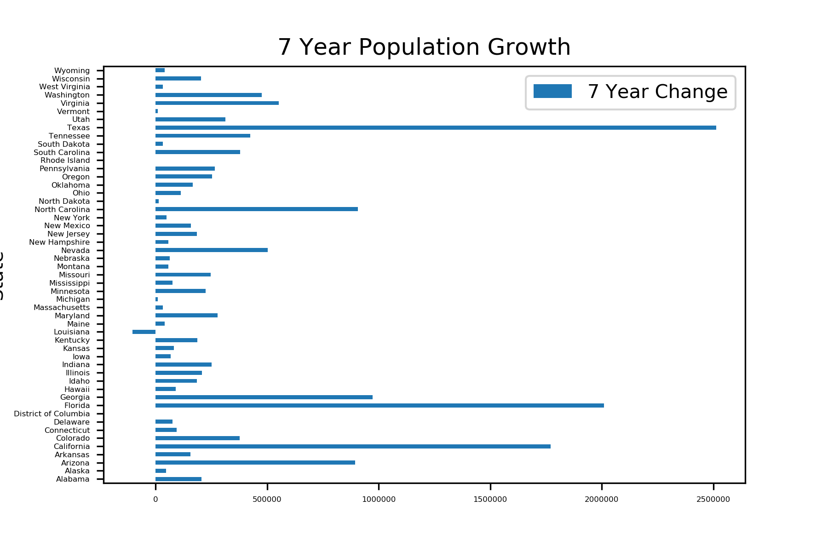
Analysis

Slide 14
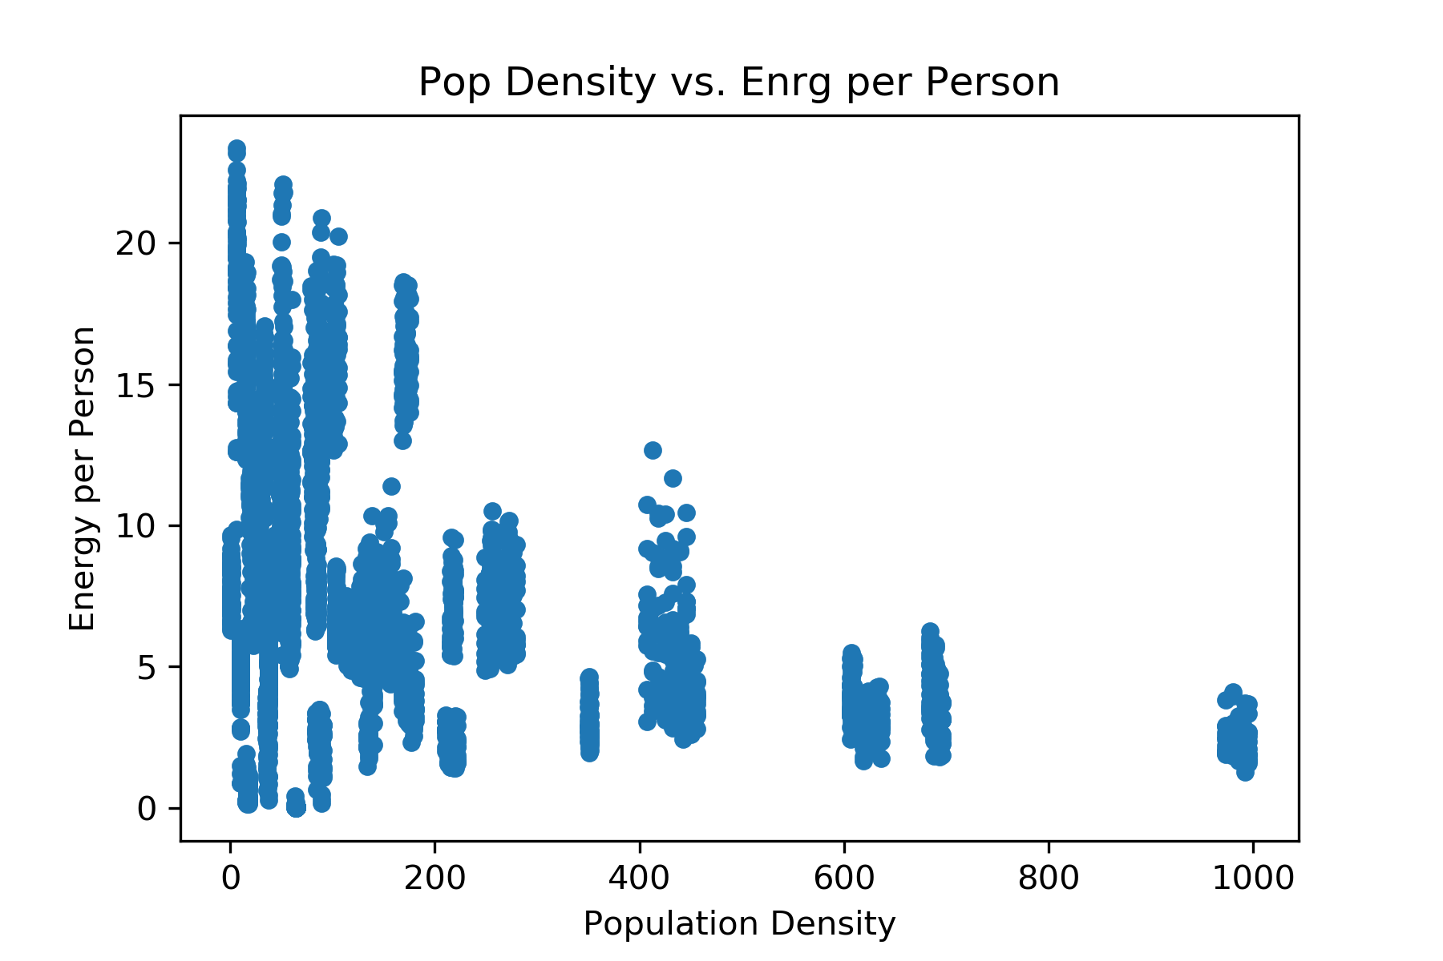
Energy usage per person

Slide 15
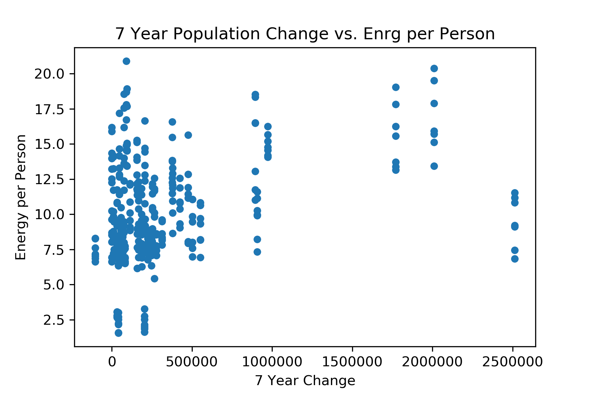
Population Change vs Energy per Person

Slide 16
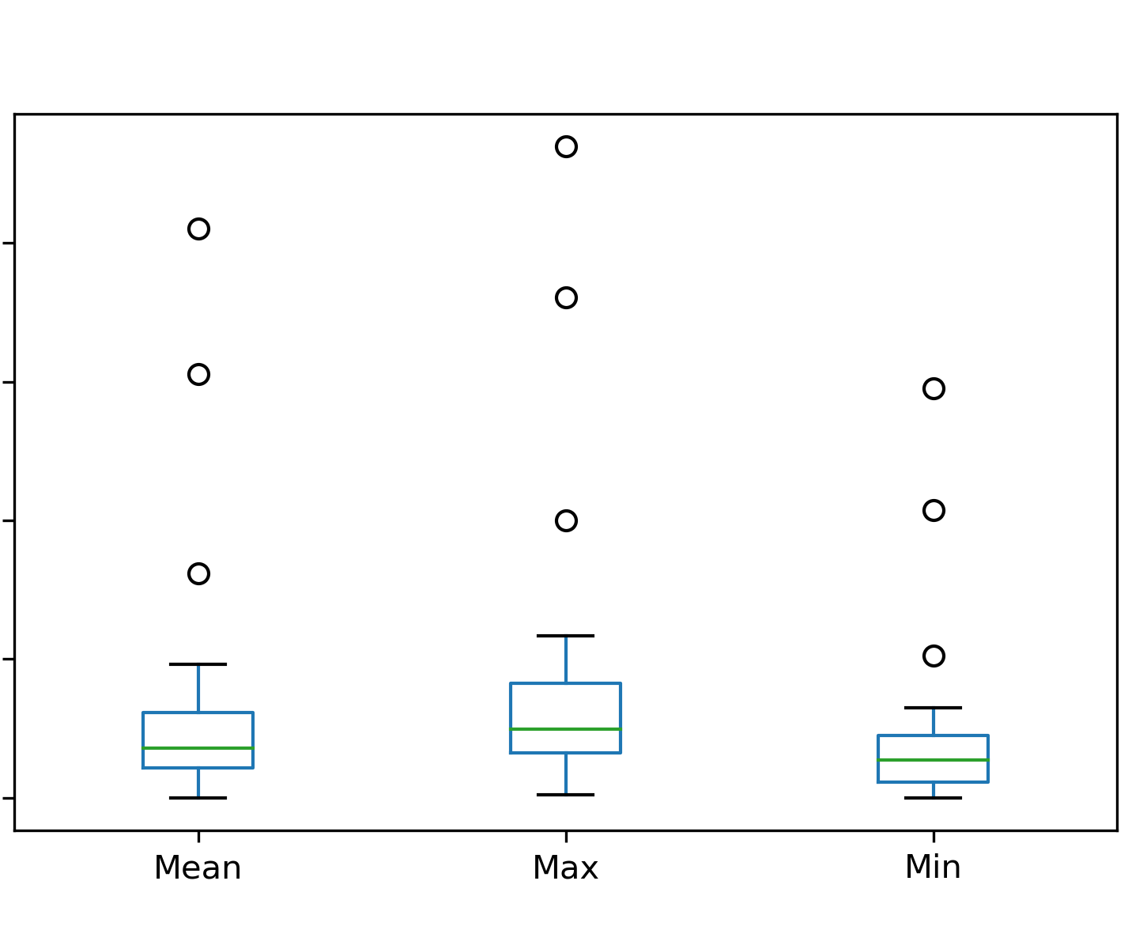
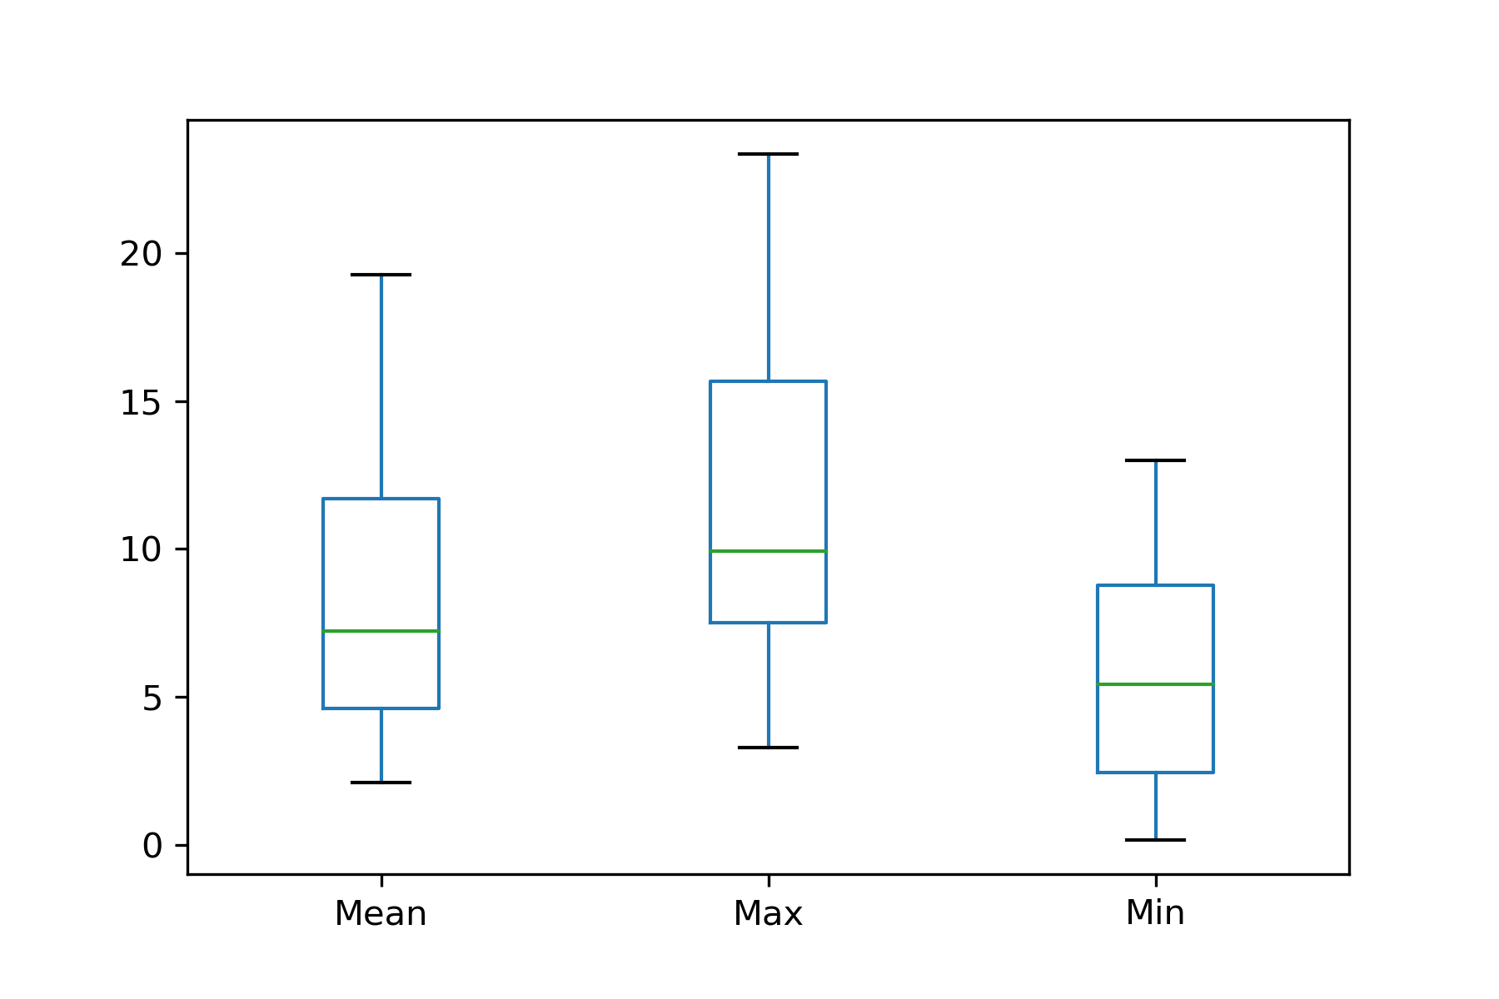
Energy Data Outliers
Energy per Person (with outliers)
Energy per Person (without outliers)

Slide 17
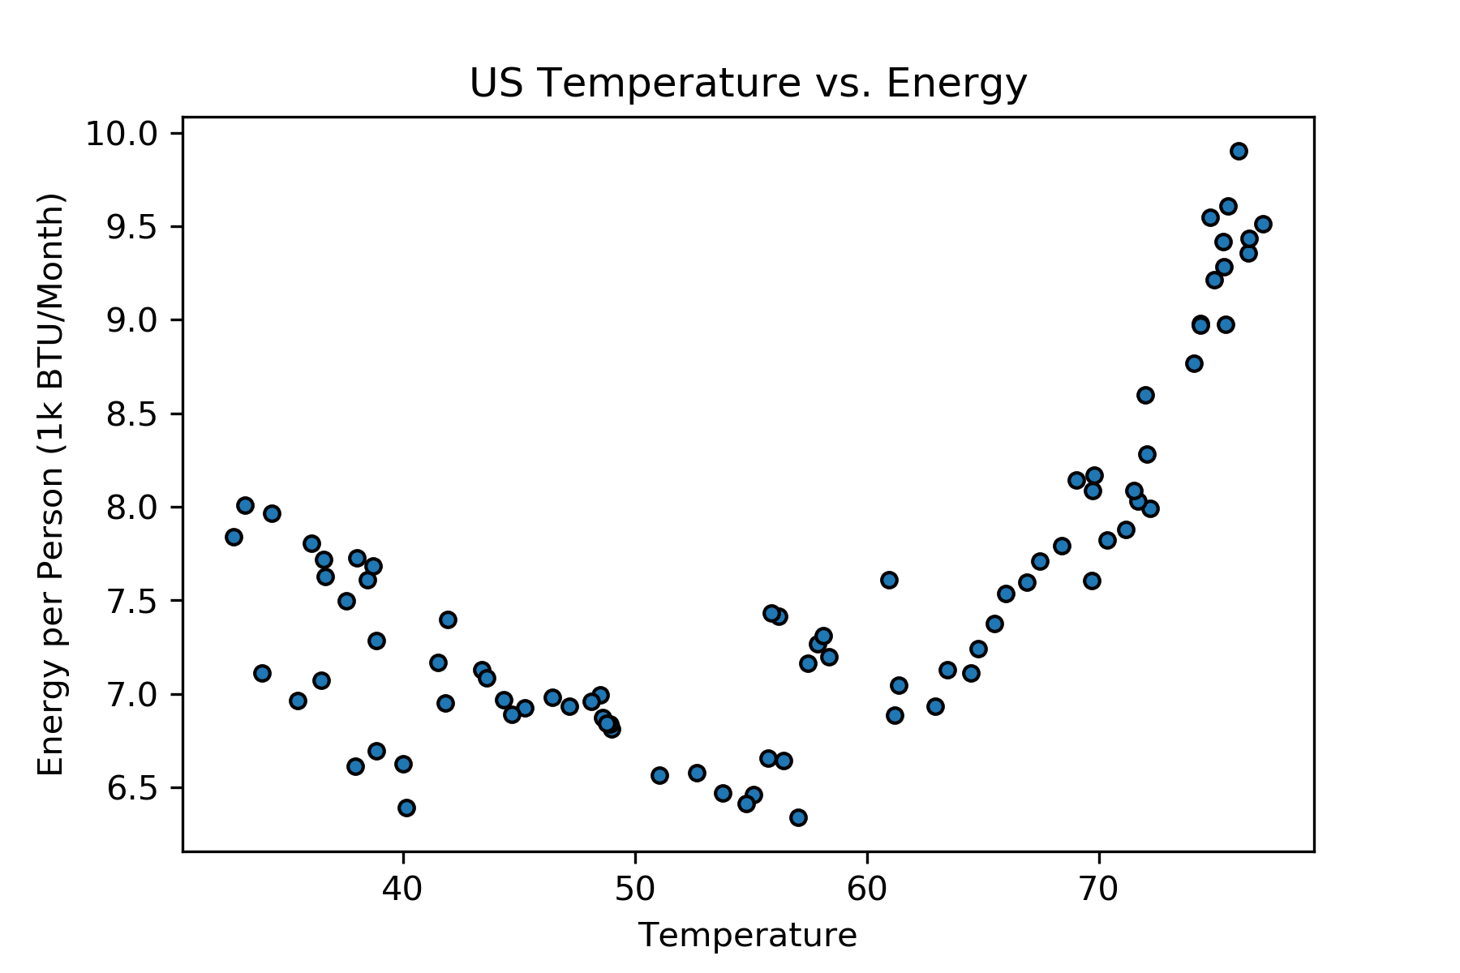
Temperature v. Energy

Slide 18
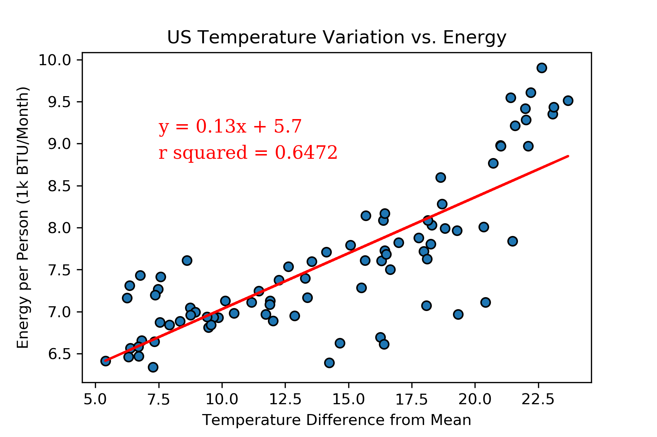
Temperature From Mean v. Energy

Slide 19
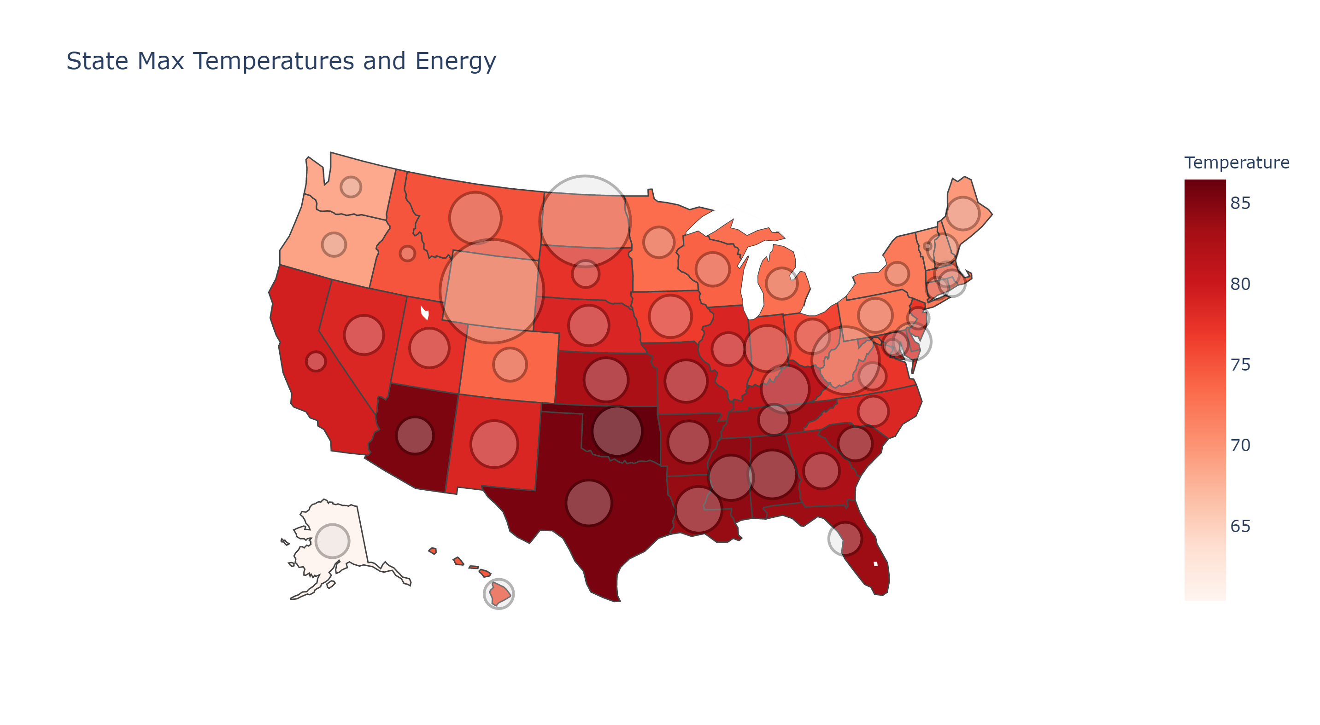

Slide 20
Implication
A large amount of our energy consumption is related to keeping ourselves comfortable

